Slide 1
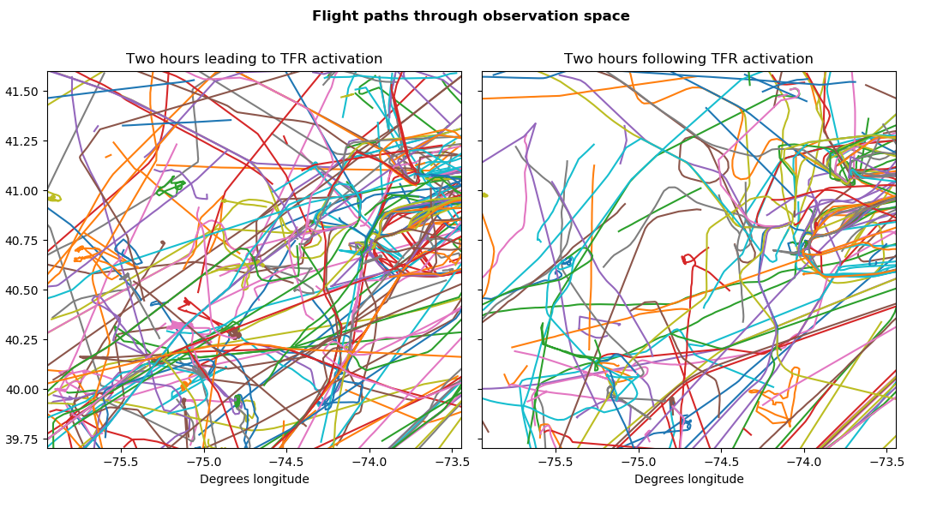

Slide 2
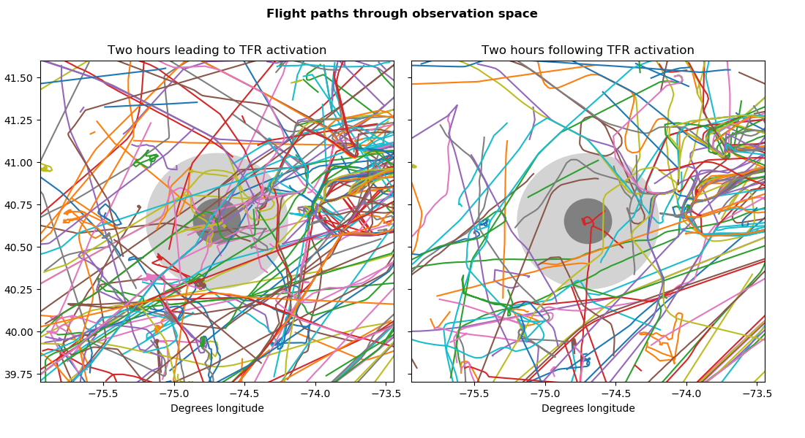

Slide 3
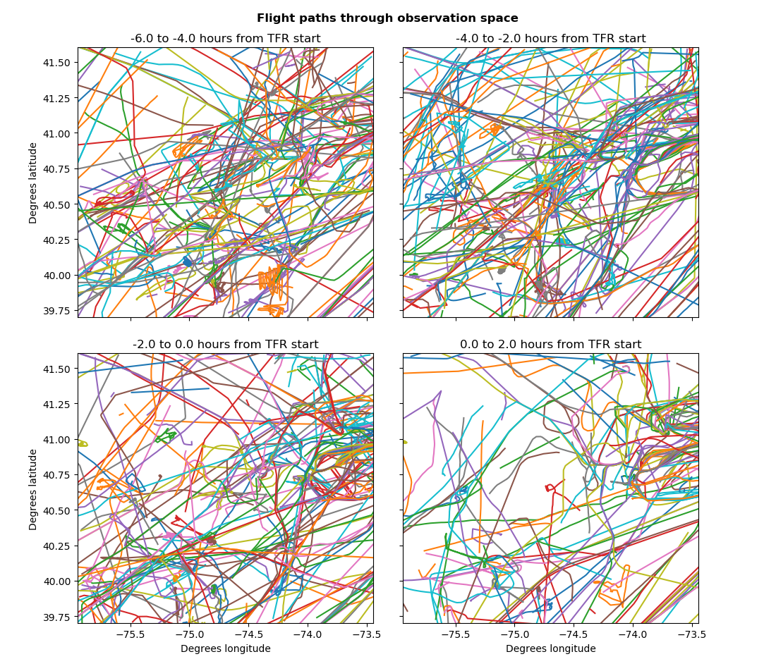

Slide 4
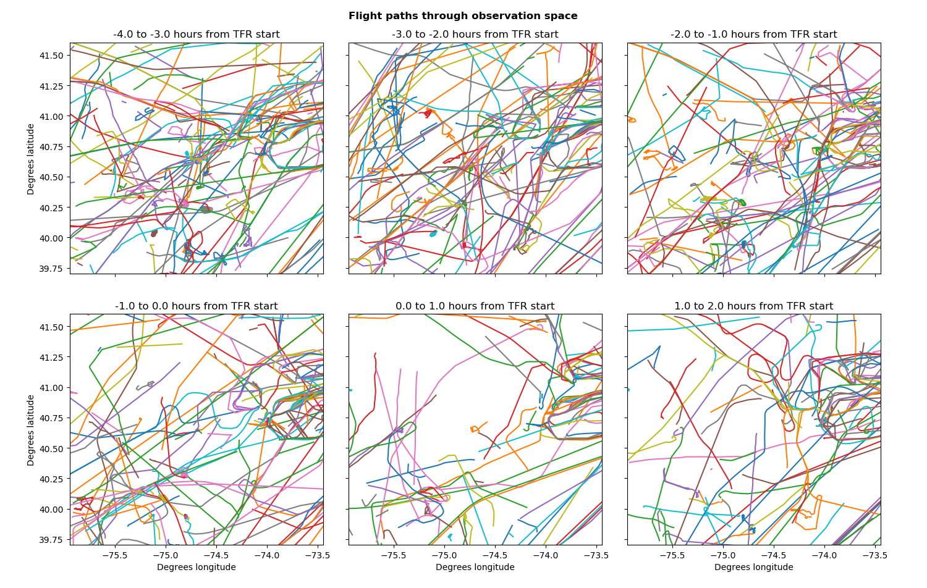

Slide 5
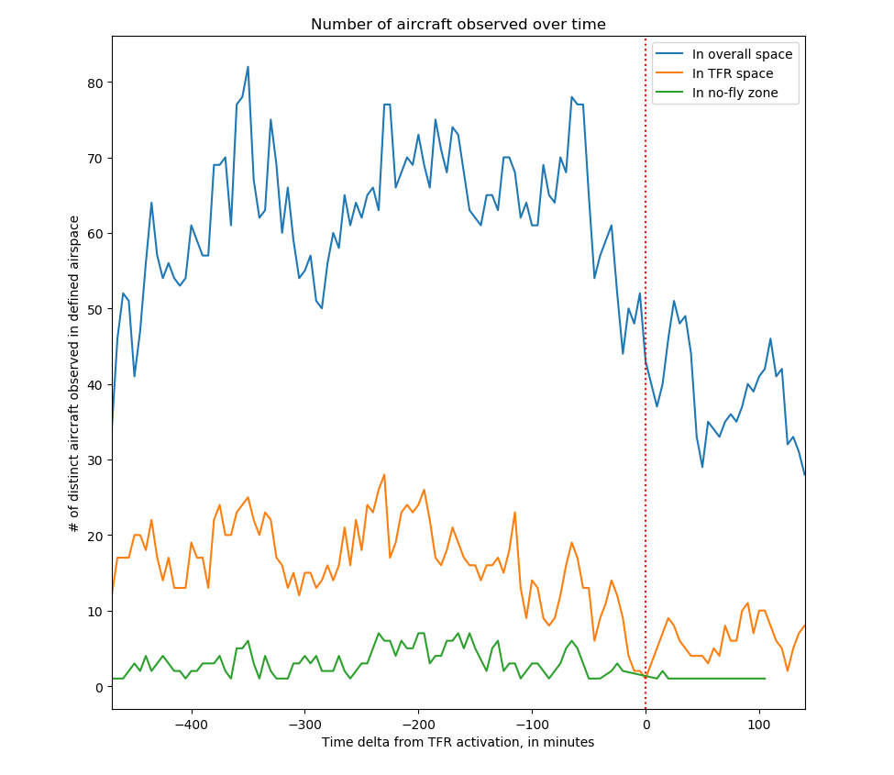

Slide 6
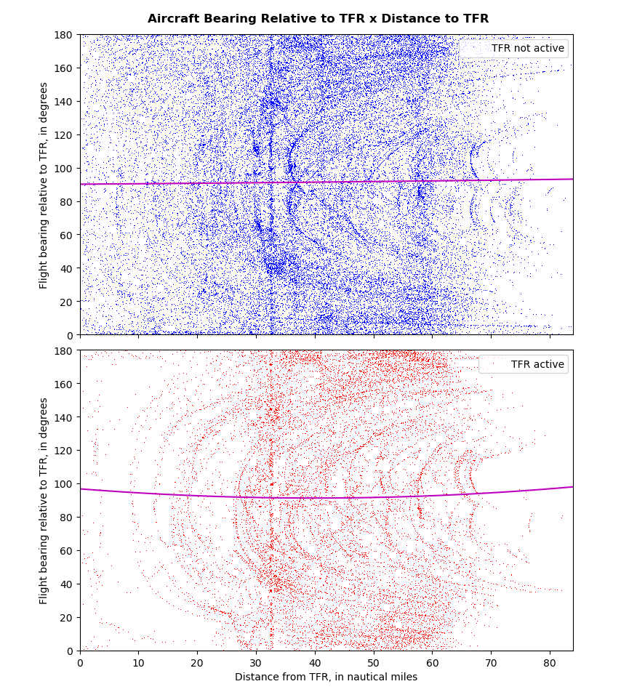

Slide 7
Bearing = 90.0530 + 0.0255(nm) + 0.0001(nm²)
Bearing = 96.7347 - 0.2766(nm) + 0.0035(nm²)

Slide 8
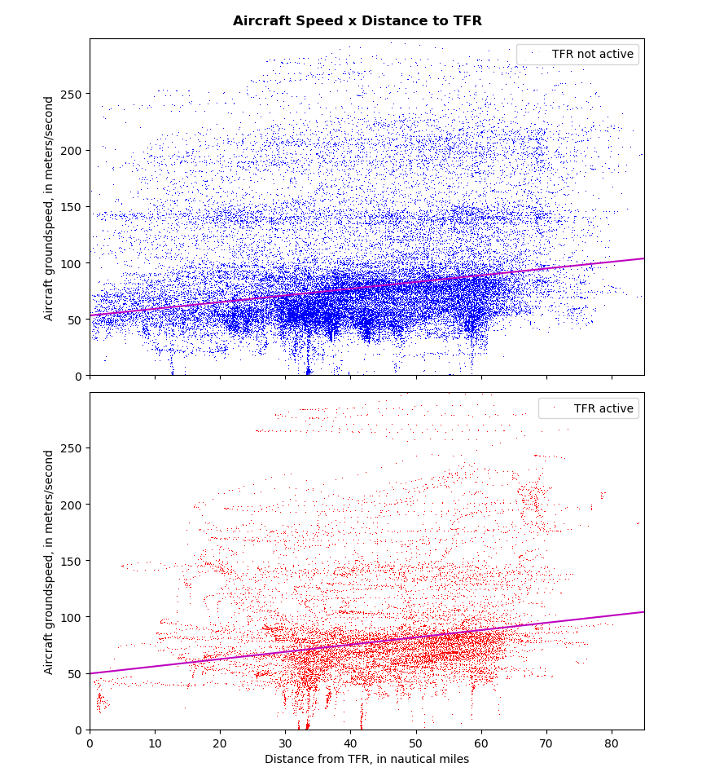

Slide 9
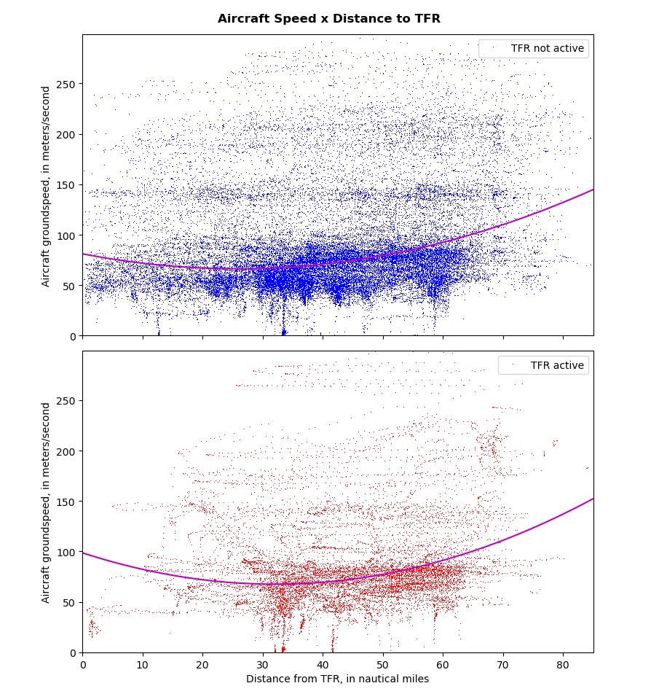

Slide 10
Velocity = 81.1362 - 1.1536(nm) + 0.0224(nm²)
Velocity = 98.6525 - 1.9389(nm) + 0.0302(nm²)

